Slide 1
CS1231S T03A
Tutorial 6: Number Theory 1

Slide 2
Learning objectives of this tutorial
reason about divisibility (including divisors and multiples) and primes
manipulate quotients and remainders
convert between different bases
reason about representations of numbers with respect to a certain base

Slide 3
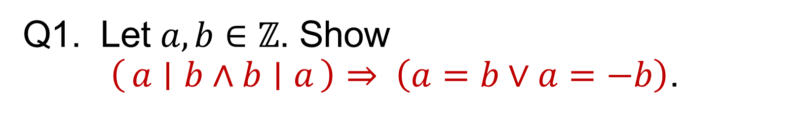
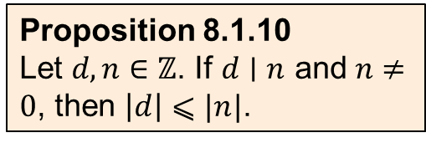
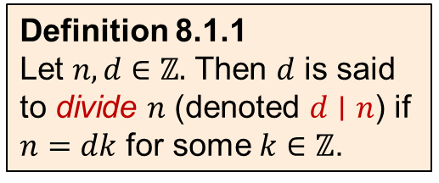
Q1. Let $a,b∈ℤ$. Show $\left(a ∣ b∧b ∣ a\right)⇒ \left(a=b∨a=−b\right)$.
Definition 8.1.1
Let $n,d∈ℤ.$ Then $d$ is said to divide $n$ (denoted $d∣n$) if $n=dk$ for some $k∈ℤ$.
Proposition 8.1.10
Let $d,n∈ℤ$. If $d∣n$ and $n≠0$, then $\left|d\right|⩽|n|$.

Slide 4
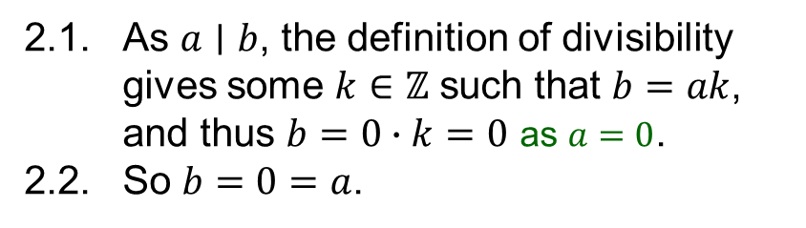
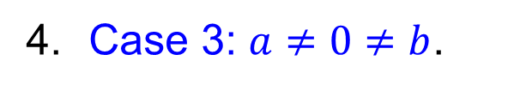
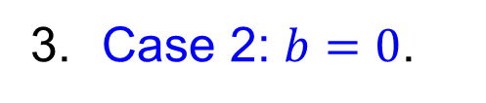
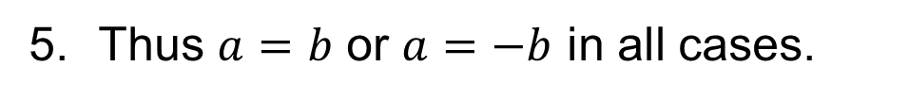
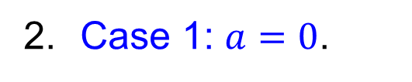
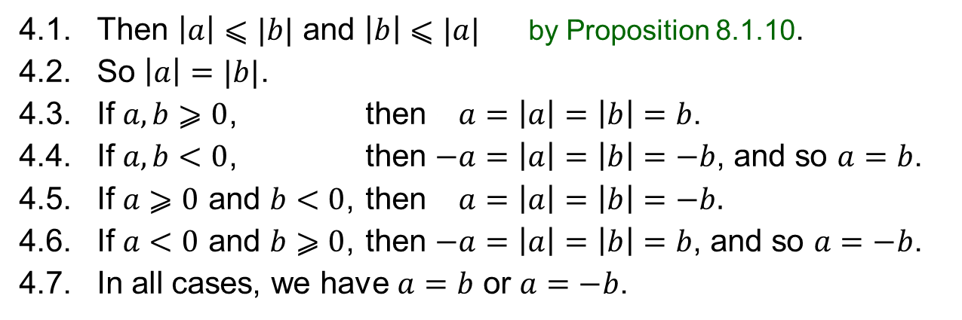
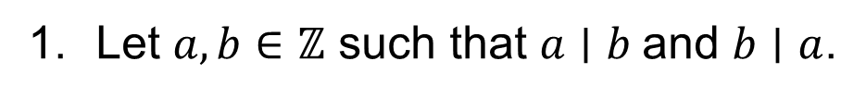
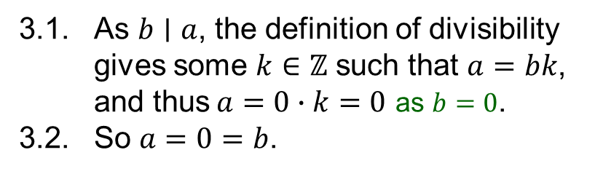
Q1. Let $a,b∈ℤ$. Show $\left(a ∣ b∧b ∣ a\right)⇒ \left(a=b∨a=−b\right)$.
Definition 8.1.1
Let $n,d∈ℤ.$ Then $d$ is said to divide $n$ (denoted $d∣n$) if $n=dk$ for some $k∈ℤ$.
1. Let $a,b∈ℤ$ such that $a∣b$and $b∣a$.
2. Case 1: $a=0$.
3. Case 2: $b=0$.
2.1. As $a∣b$, the definition of divisibility gives some $k∈ℤ$ such that $b=ak$,
and thus $b=0∙k=0$ as $a=0$.
2.2. So $b=0=a$.
3.1. As $b∣a$, the definition of divisibility gives some $k∈ℤ$ such that $a=bk$,
and thus$a=0∙k=0$ as $b=0$.
3.2. So $a=0=b$.
4. Case 3: $a≠0≠b$.
4.1. Then $\left|a\right|⩽|b|$ and $\left|b\right|⩽|a|$ by Proposition 8.1.10.
4.2. So $\left|a\right|=|b|$.
4.3. If $a,b⩾0$, then $−a=\left|a\right|=\left|b\right|=b$.
4.4. If $a,b<0$, then $−a=\left|a\right|=\left|b\right|=−b$, and so $a=b$.
4.5. If $a⩾0$ and $b<0$, then $−a=\left|a\right|=\left|b\right|=−b.$
4.6. If $a<0$ and $b⩾0$, then $−a=\left|a\right|=\left|b\right|=b$, and so $a=−b$.
4.7. In all cases, we have $a=b$ or $a=−b$.
Proposition 8.1.10
Let $d,n∈ℤ$. If $d∣n$ and $n≠0$, then $\left|d\right|⩽|n|$.
5. Thus $a=b$ or $a=−b$ in all cases.

Slide 5
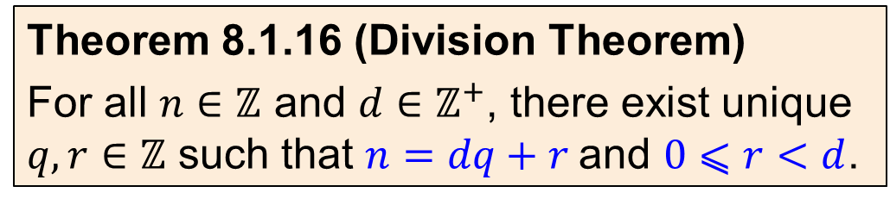
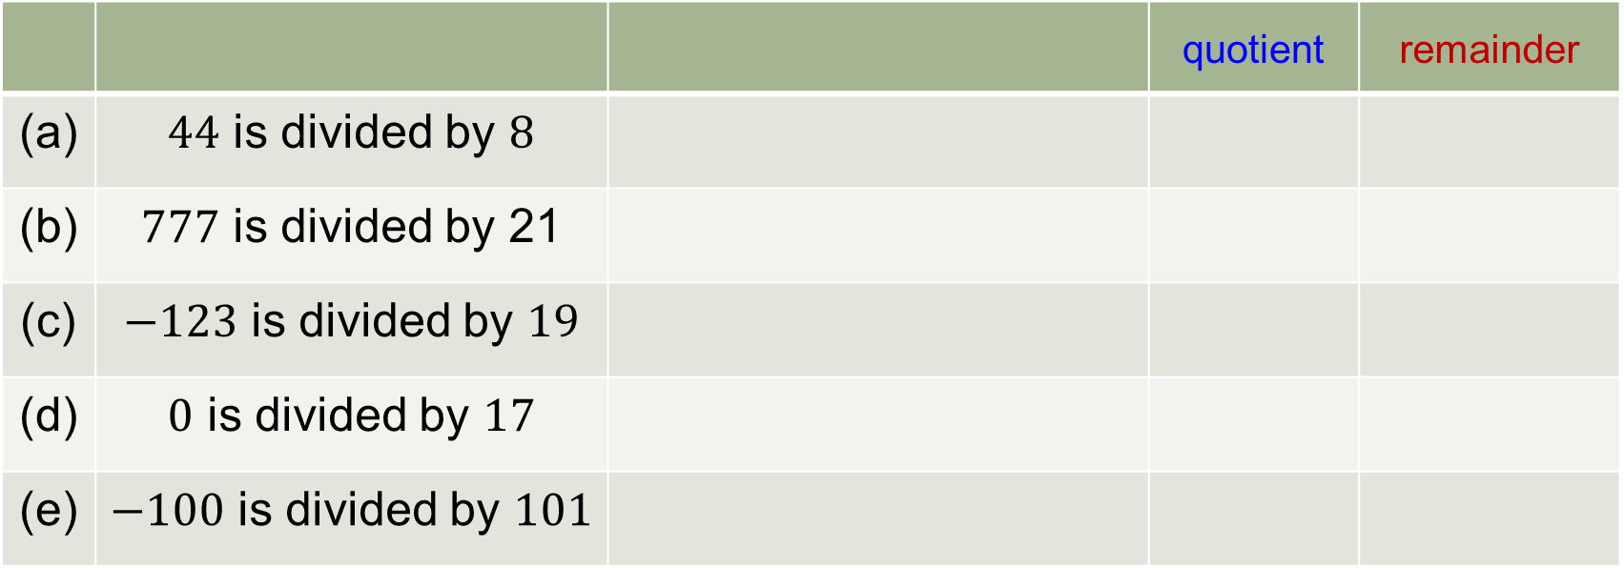
Q2. Find the quotient and the remainder when
 |  |  | quotient | remainder
(a) | $44$ is divided by $8$
(b) | $777$ is divided by 21
(c) | $−123$ is divided by $19$
(d) | $0$ is divided by $17$
(e) | $−100$ is divided by $101$
Theorem 8.1.16 (Division Theorem)
For all $n∈ℤ$ and $d∈ℤ^{+}$, there exist unique $q,r∈ℤ$ such that $n=dq+r$and $0⩽r<d$.

Slide 6















Q2. Find the quotient and the remainder when
 |  |  | quotient | remainder
(a) | $44$ is divided by $8$
(b) | $777$ is divided by 21
(c) | $−123$ is divided by $19$
(d) | $0$ is divided by $17$
(e) | $−100$ is divided by $101$
$$44= 8×5+4$$
$$5$$
$$4$$
$$777=21×37+0$$
$$37$$
$$0$$
$$−123=19×(−7)+10$$
$$−7$$
$$10$$
$$0=17×0+0$$
$$0$$
$$0$$
$$−100=101×(−1)+1$$
$$−1$$
$$1$$
Theorem 8.1.16 (Division Theorem)
For all $n∈ℤ$ and $d∈ℤ^{+}$, there exist unique $q,r∈ℤ$ such that $n=dq+r$and $0⩽r<d$.

Slide 7
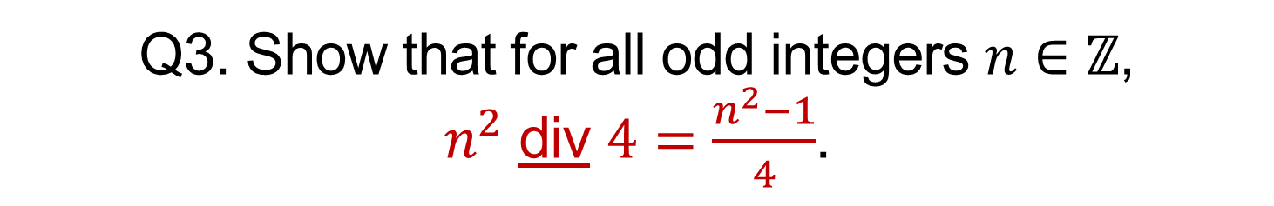
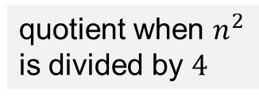
Q3. Show that for all odd integers $n∈ℤ$, $n^{2}$ div $4=\frac{n^{2}−1}{4}$.
quotient when $n^{2}$ is divided by $4$
Theorem 8.1.16 (Division Theorem)
For all $n∈ℤ$ and $d∈ℤ^{+}$, there exist unique $q,r∈ℤ$ such that $n=dq+r$and $0⩽r<d$.

Slide 8
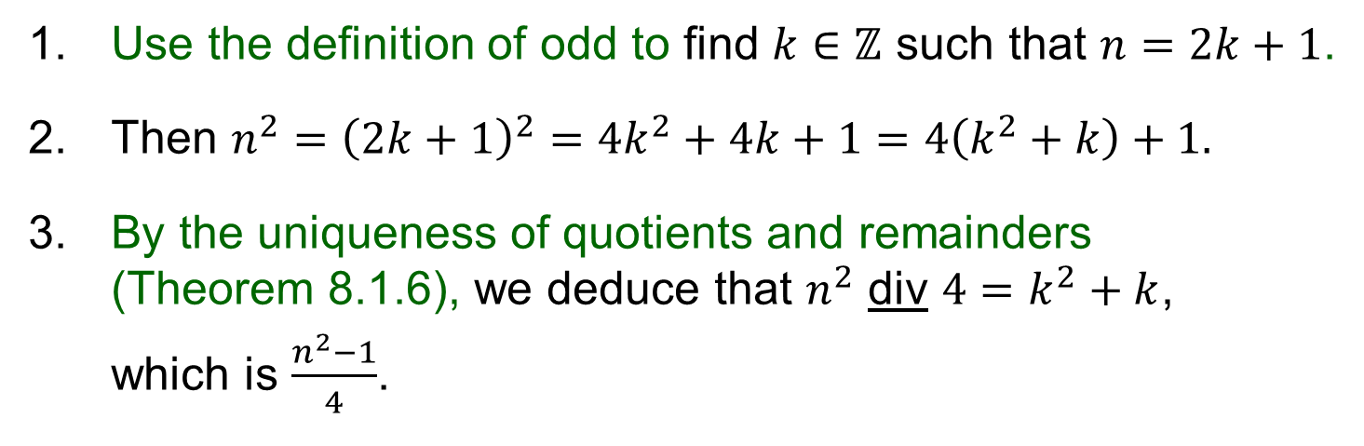
Q3. Show that for all odd integers $n∈ℤ$, $n^{2}$ div $4=\frac{n^{2}−1}{4}$.
quotient when $n^{2}$ is divided by $4$
1. Use the definition of odd to find $k∈ℤ$ such that $n=2k+1$.
2. Then $n^{2}={\left(2k+1\right)}^{2}=4k^{2}+4k+1=4\left(k^{2}+k\right)+1.$
3. By the uniqueness of quotients and remainders (Theorem 8.1.6), we deduce that $n^{2}$ div $4=k^{2}+k$,
which is $\frac{n^{2}−1}{4}$.
Theorem 8.1.16 (Division Theorem)
For all $n∈ℤ$ and $d∈ℤ^{+}$, there exist unique $q,r∈ℤ$ such that $n=dq+r$and $0⩽r<d$.

Slide 9
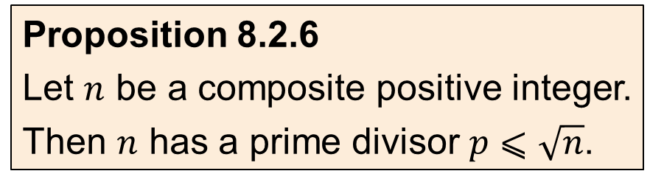
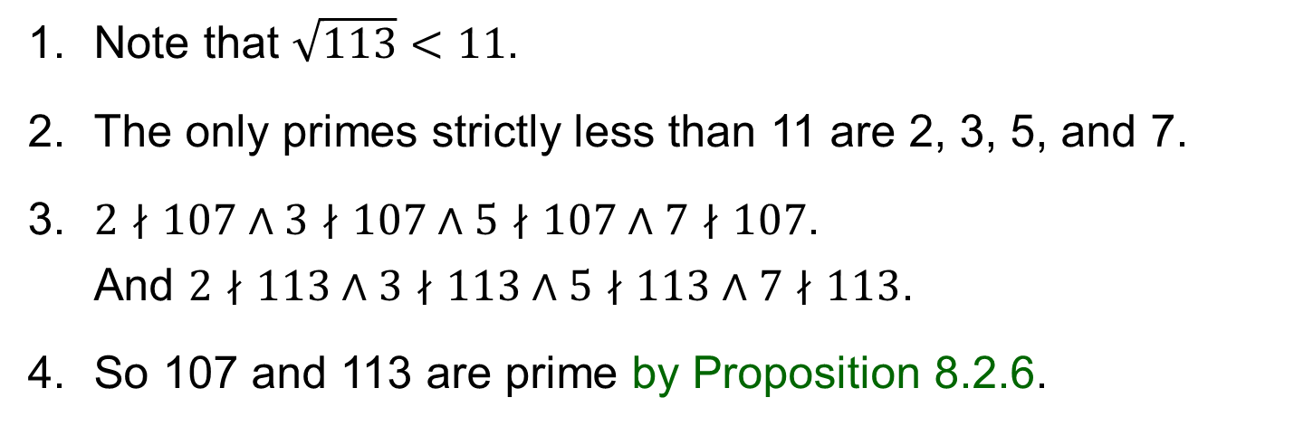
Q4. Is 107 prime? Is 113 prime?
1. Note that $\sqrt{113}<11$.
2. The only primes strictly less than 11 are 2, 3, 5, and 7.
3. $2∤107∧3∤107∧5∤107∧7∤107$.
And $2∤113∧3∤113∧5∤113∧7∤113$.
4. So 107 and 113 are prime by Proposition 8.2.6.
Proposition 8.2.6
Let $n$ be a composite positive integer.
Then $n$ has a prime divisor $p⩽\sqrt{n}$.

Slide 10
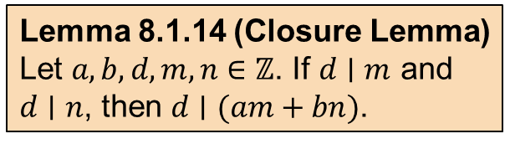
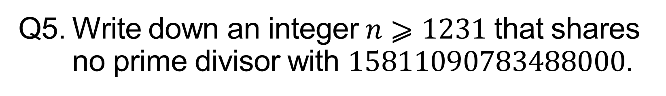
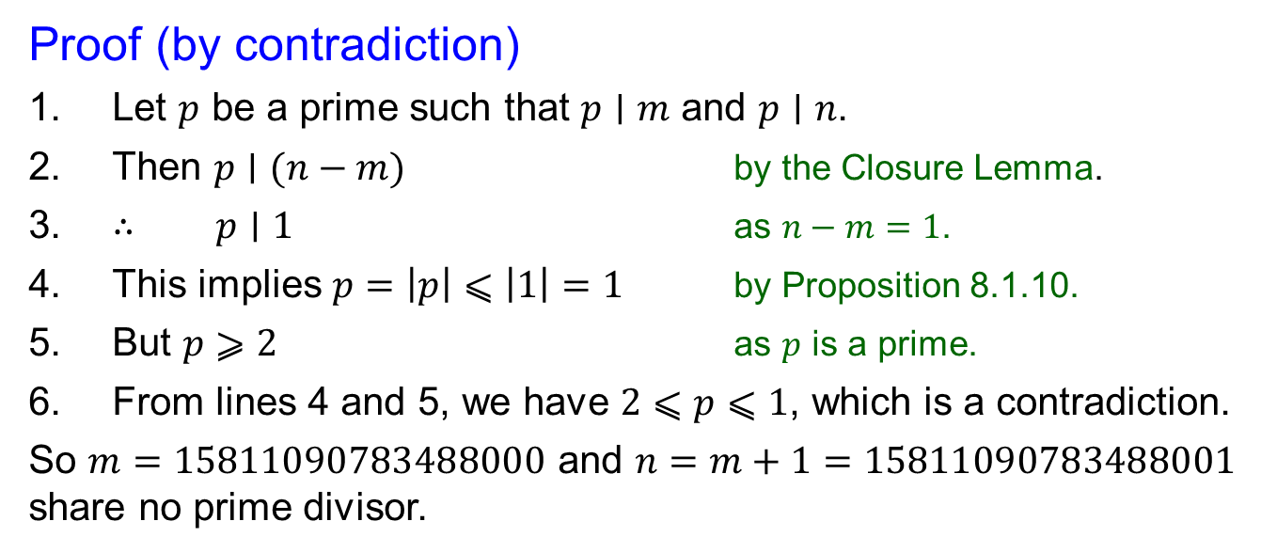
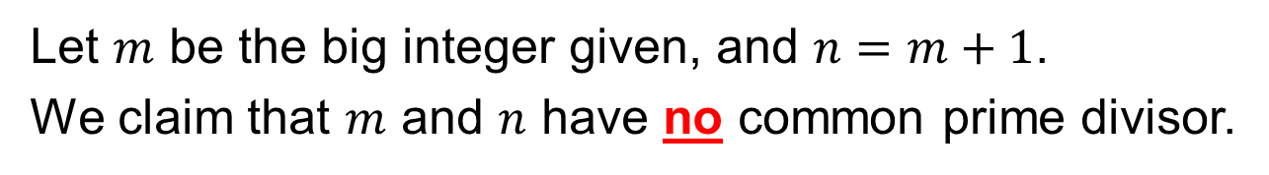
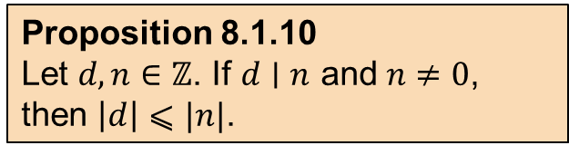
Q5. Write down an integer$n⩾1231$ that shares no prime divisor with $15811090783488000$.
Let $m$ be the big integer given, and $n=m+1$.
We claim that $m$ and $n$ have no common prime divisor.
Lemma 8.1.14 (Closure Lemma)
Let $a,b,d,m,n∈ℤ$. If $d∣m$ and
$d∣n$, then $d∣(am+bn)$.
Proof (by contradiction)
1. Let $p$ be a prime such that $p∣m$ and $p∣n$.
2. Then $p∣(n−m)$ by the Closure Lemma.
3. $∴ p∣1$ as $n−m=1$.
4. This implies $p=\left|p\right|⩽\left|1\right|=1$ by Proposition 8.1.10.
5. But $p⩾2$ as $p$ is a prime.
6. From lines 4 and 5, we have $2⩽p⩽1$, which is a contradiction.
So $m=15811090783488000$ and $n=m+1=15811090783488001$ share no prime divisor.
Proposition 8.1.10
Let $d,n∈ℤ$. If $d∣n$ and $n≠0$, then $\left|d\right|⩽|n|$.

Slide 11
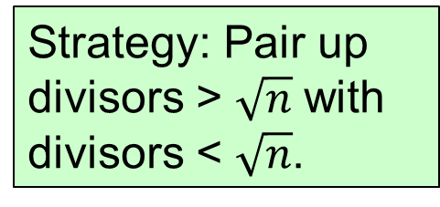
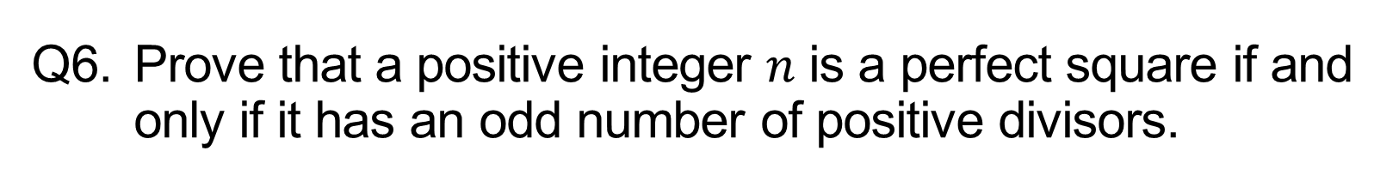
Q6. Prove that a positive integer $n$ is a perfect square if and only if it has an odd number of positive divisors.
Perfect squares
Not perfect squares
16
20
Strategy: Pair up divisors > $\sqrt{n}$ with divisors < $\sqrt{n}$.
1
16
1
20
2
8
2
10
4
4
5
144
96
1
144
1
96
2
72
2
48
3
48
3
32
4
36
4
24
6
24
6
16
8
18
8
12
12

Slide 12
Q6. Prove that a positive integer $n$ is a perfect square if and only if it has an odd number of positive divisors.

Slide 13
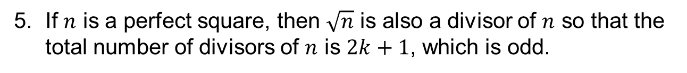
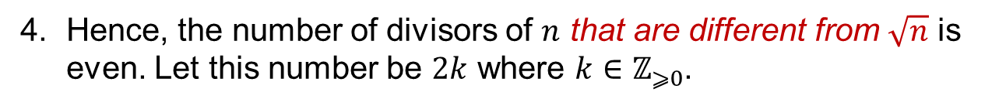
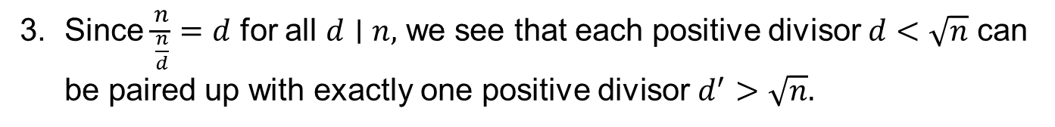
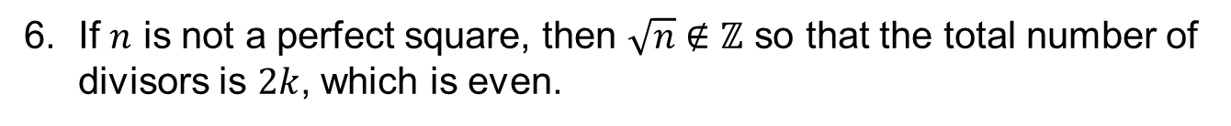
Q6. Prove that a positive integer $n$ is a perfect square if and only if it has an odd number of positive divisors.
16
1. If $d∣n$ with $1⩽d<\sqrt{n},$then $\sqrt{n}<\frac{n}{d}⩽n$ and $\frac{n}{d}∣n$.
1
16
2
8
2. Similarly, if $d∣n$ with $\sqrt{n}<d⩽n$, then $1⩽\frac{n}{d}<\sqrt{n}$ and $\frac{n}{d}∣n$.
4
3. Since $\frac{n}{\frac{n}{d}}=d$ for all $d∣n,$ we see that each positive divisor $d<\sqrt{n}$ can be paired up with exactly one positive divisor $d^{′}>\sqrt{n}.$
20
1
20
4. Hence, the number of divisors of $n$ that are different from $\sqrt{n}$ is even. Let this number be $2k$ where $k∈ℤ_{⩾0}$.
2
10
4
5
5. If $n$ is a perfect square, then $\sqrt{n}$ is also a divisor of $n$ so that the total number of divisors of $n$ is $2k+1$, which is odd.
6. If $n$ is not a perfect square, then $\sqrt{n}∉ℤ$ so that the total number of divisors is $2k$, which is even.

Slide 14
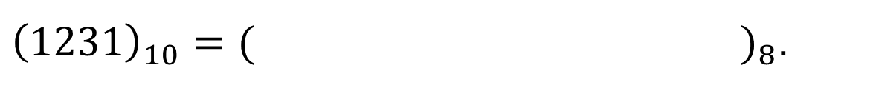
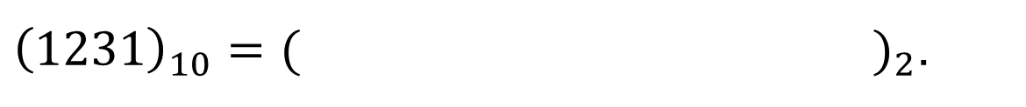
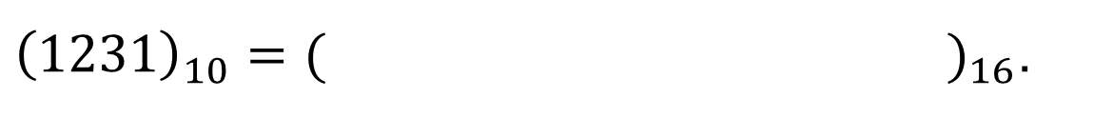
Q7. Find the binary, octal and hexadecimal representations of 1231.
${\left(1231\right)}_{10}={( )}_{2}$.
${\left(1231\right)}_{10}={( )}_{8}$.
${\left(1231\right)}_{10}={( )}_{16}$.

Slide 15
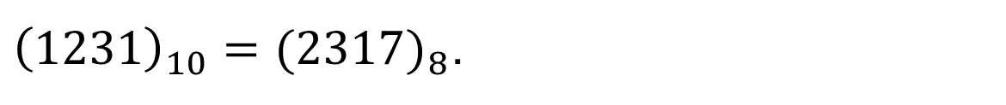
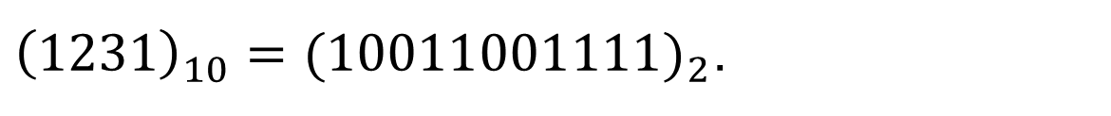
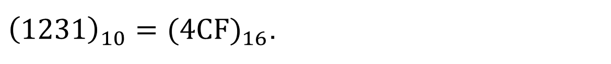
Q7. Find the binary, octal and hexadecimal representations of 1231.
${\left(1231\right)}_{10}={(10011001111)}_{2}$.
${\left(1231\right)}_{10}={(2317)}_{8}$.
${\left(1231\right)}_{10}={(4CF)}_{16}$.

Slide 16
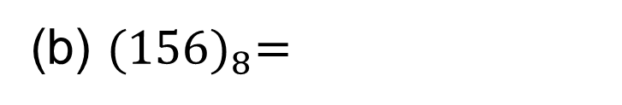
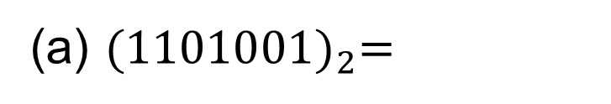
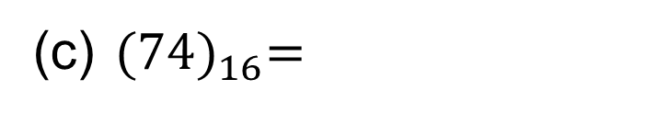
Q8. Find the decimal representations of
(a) ${(1101001)}_{2}=$
(b) ${(156)}_{8}=$
(c) ${(74)}_{16}=$

Slide 17
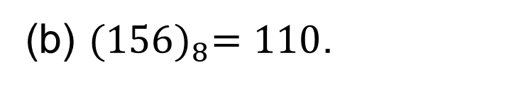
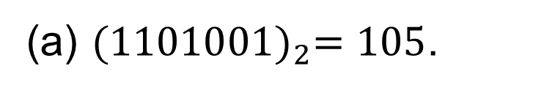
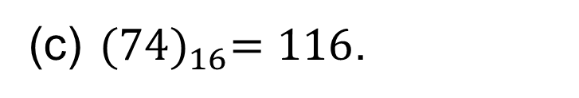
Q8. Find the decimal representations of
(a) ${(1101001)}_{2}=105$.
(b) ${(156)}_{8}=110$.
(c) ${(74)}_{16}=116$.

Slide 18
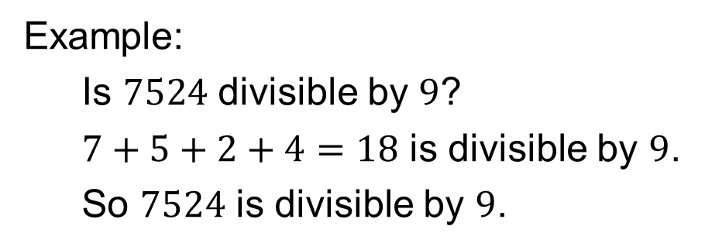
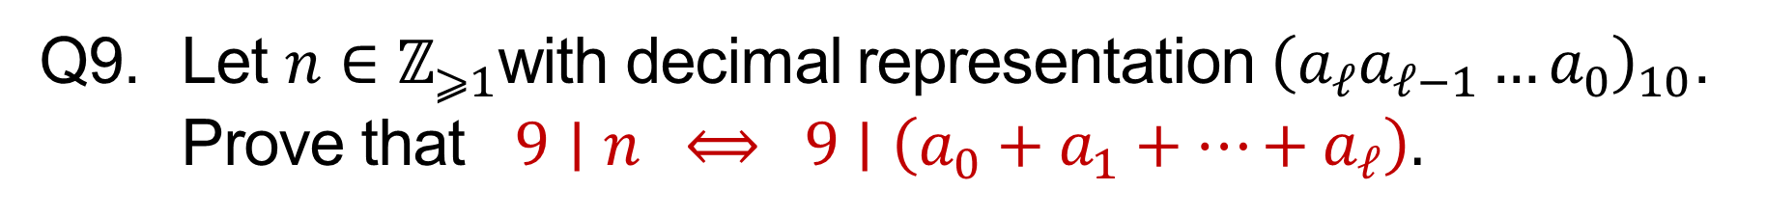
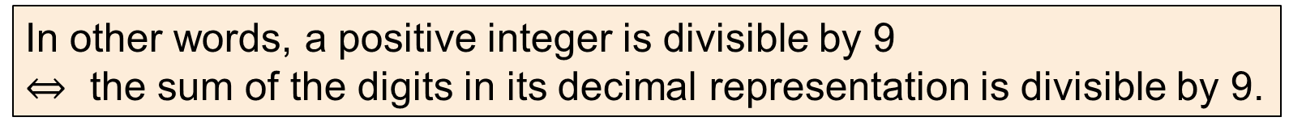
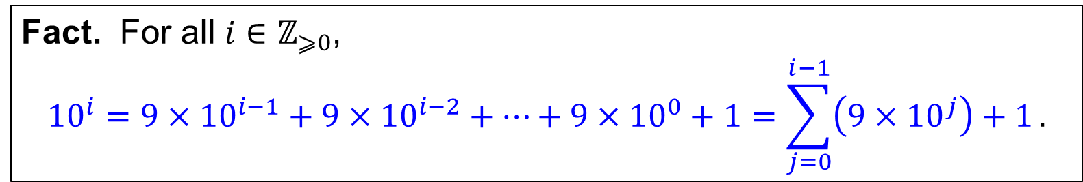
Q9. Let $n∈ℤ_{⩾1}$with decimal representation ${\left(a_{ℓ}a_{ℓ−1}…a_{0}\right)}_{10}$. Prove that $9∣n ⟺ 9∣\left(a_{0}+a_{1}+⋯+a_{ℓ}\right).$
In other words, a positive integer is divisible by 9
$⇔$ the sum of the digits in its decimal representation is divisible by 9.
Example:
Is $7524$ divisible by $9$?
$7+5+2+4=18$ is divisible by $9$.
So $7524$ is divisible by $9$.
Fact. For all $i∈ℤ_{⩾0}$,
$${10}^{i}=9×{10}^{i−1}+9×{10}^{i−2}+⋯+9×{10}^{0}+1=\sum_{j=0}^{i−1}{\left(9×{10}^{j}\right)+1}.$$

Slide 19
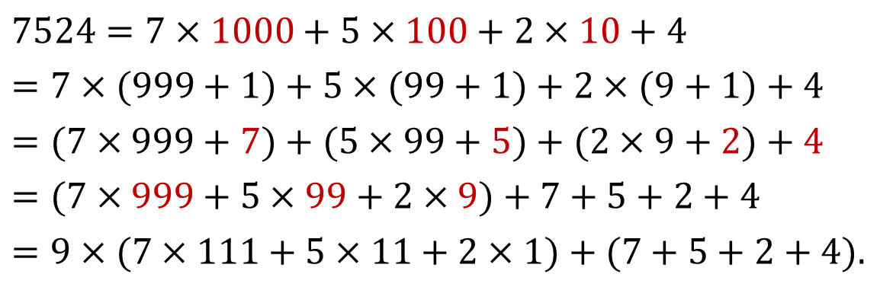
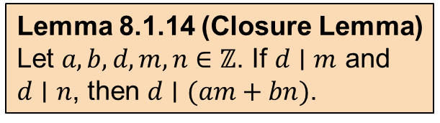
Q9. Let $n∈ℤ_{⩾1}$with decimal representation ${\left(a_{ℓ}a_{ℓ−1}…a_{0}\right)}_{10}$. Prove that $9∣n ⟺ 9∣\left(a_{0}+a_{1}+⋯+a_{ℓ}\right).$
In other words, a positive integer is divisible by 9
$⇔$ the sum of the digits in its decimal representation is divisible by 9.
$$7524=7×1000+5×100+2×10+4$$
$$=7×(999+1)+5×(99+1)+2×(9+1)+4$$
$$=(7×999+7)+(5×99+5)+(2×9+2)+4$$
$$=(7×999+5×99+2×9)+7+5+2+4$$
$$=9×(7×111+5×11+2×1)+(7+5+2+4).$$
Lemma 8.1.14 (Closure Lemma)
Let $a,b,d,m,n∈ℤ$. If $d∣m$ and
$d∣n$, then $d∣(am+bn)$.
Fact. For all $i∈ℤ_{⩾0}$,
$${10}^{i}=9×{10}^{i−1}+9×{10}^{i−2}+⋯+9×{10}^{0}+1=\sum_{j=0}^{i−1}{\left(9×{10}^{j}\right)+1}.$$

Slide 20
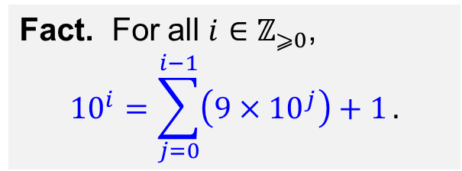
Q9. Let $n∈ℤ_{⩾1}$with decimal representation ${\left(a_{ℓ}a_{ℓ−1}…a_{0}\right)}_{10}$. Prove that $9∣n ⟺ 9∣\left(a_{0}+a_{1}+⋯+a_{ℓ}\right).$
Fact. For all $i∈ℤ_{⩾0}$,
$${10}^{i}=\sum_{j=0}^{i−1}{\left(9×{10}^{j}\right)+1}.$$
Lemma 8.1.14 (Closure Lemma)
Let $a,b,d,m,n∈ℤ$. If $d∣m$ and
$d∣n$, then $d∣(am+bn)$.

Slide 21
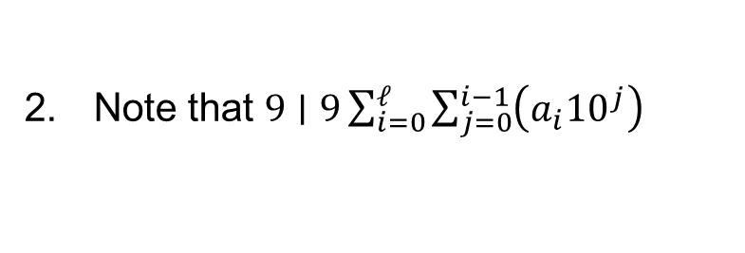
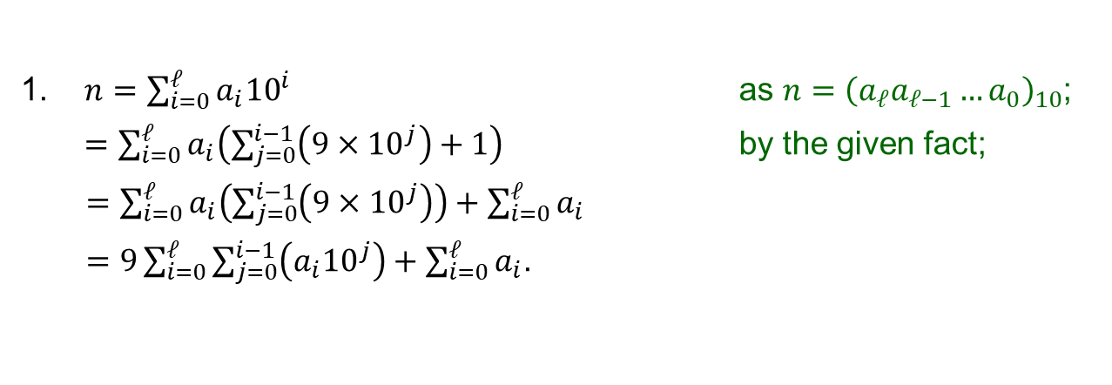




Q9. Let $n∈ℤ_{⩾1}$with decimal representation ${\left(a_{ℓ}a_{ℓ−1}…a_{0}\right)}_{10}$. Prove that $9∣n ⟺ 9∣\left(a_{0}+a_{1}+⋯+a_{ℓ}\right).$
1. $n=\sum_{i=0}^{ℓ}{a_{i}{10}^{i}}$ as $n={\left(a_{ℓ}a_{ℓ−1}…a_{0}\right)}_{10}$;
$=\sum_{i=0}^{ℓ}{a_{i}\left(\sum_{j=0}^{i−1}{\left(9×{10}^{j}\right)}+1\right)}$ by the given fact;
$=\sum_{i=0}^{ℓ}{a_{i}\left(\sum_{j=0}^{i−1}{\left(9×{10}^{j}\right)}\right)}+\sum_{i=0}^{ℓ}{a_{i}}$
$=9\sum_{i=0}^{ℓ}{\sum_{j=0}^{i−1}{\left({a_{i}10}^{j}\right)}}+\sum_{i=0}^{ℓ}{a_{i}}$.
Fact. For all $i∈ℤ_{⩾0}$,
$${10}^{i}=\sum_{j=0}^{i−1}{\left(9×{10}^{j}\right)+1}.$$
Basic properties of summation.
$\sum_{i=k}^{ℓ}{a_{i}}+\sum_{i=k}^{ℓ}{b_{i}}=\sum_{i=k}^{ℓ}{(a_{i}+b_{i})}$.
$c\sum_{i=k}^{ℓ}{a_{i}}=\sum_{i=k}^{ℓ}{ca_{i}}$.
2. Note that $9∣9\sum_{i=0}^{ℓ}{\sum_{j=0}^{i−1}{\left({a_{i}10}^{j}\right)}}$
If $9∣n$, then
3.1. $9∣\left(n−9\sum_{i=0}^{ℓ}{\sum_{j=0}^{i−1}{\left({a_{i}10}^{j}\right)}}\right)$ by the Closure Lemma;
3.2. $∴ 9∣\sum_{i=0}^{ℓ}{a_{i}}$ by line 1.
Lemma 8.1.14 (Closure Lemma)
Let $a,b,d,m,n∈ℤ$. If $d∣m$ and
$d∣n$, then $d∣(am+bn)$.
Conversely, if $9∣\sum_{i=0}^{ℓ}{a_{i}}$, then
4.1. $9∣\left(9\sum_{i=0}^{ℓ}{\sum_{j=0}^{i−1}{\left({a_{i}10}^{j}\right)}}+\sum_{i=0}^{ℓ}{a_{i}}\right)$ by the Closure Lemma;
4.2. $∴ 9∣n$ by line 1.
5. We conclude that $9∣n ⇔ 9∣\sum_{i=0}^{ℓ}{a_{i}}$ by lines 3 and 4.

